Slide 1

SECURE PARKING WITH QR PAYMENTS AND AI SURVEILLANCE
Guided by:
Dr. Anitha R. Associate professor Dept. of ECE
Presented by:
SUBITH S

Slide 2
AIM
To increase safety with cameras that detect vulnerabilities and alerts authorities which ensures a full security to vehicles
To ensure user convenience with digital pins and QR codes for payment and unlock
Also to offer real-time space availability, vulnerability, providing improved convenience and security

Slide 3
OBJECTIVES
PIN-Based Car Locking System: Uses a temporary PIN to raise spikes, locking the vehicle securely.
QR Code Payment System: Allows users to pay via QR code before unlocking the vehicle.
Security Camera System: Monitors the vehicle for detecting suspicious activities.
Web Application: Platform for payments, Resevation, Pin Generation

Slide 4
OBJECTIVES
Spike Control Mechanism: Raises/lowers spikes based on PIN and payment actions.
Real-Time Monitoring and Alert System: Provides live camera, Vibration sensors and alerts the authorities .
Smart Parking Availability System: Monitor 3 real-time parking space availability as a demo and receive instant updates in web app

Slide 5
DESIGN
First section is the parking area which includes Rasberry pi along with IR sensor, Tilt sensor , camera.
The user interacts with the parking area with the help of these devices.
Second section contains the cloud-based web services which acts a mediator between the user and parking area.
The cloud is updated depending upon the availability of the parking area
Third section is the parking payment side.
The user gets payment page and can pay through Razorpay Gateway. Which in turn descends the spike setup.

Slide 6
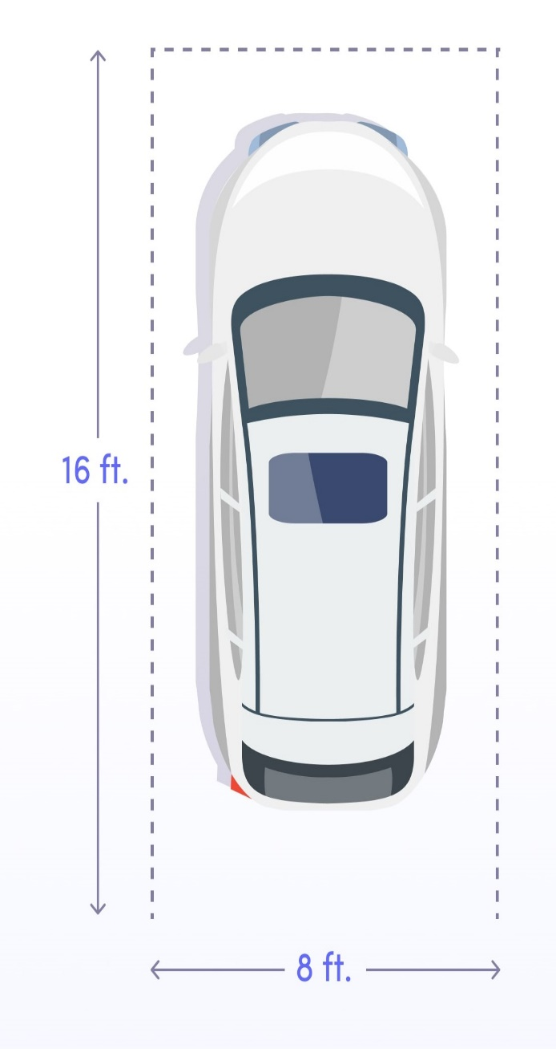


S
SLOT 1
SLOT 2
SLOT 3
SLOT 4
AVAILABLE SLOT

Slide 7
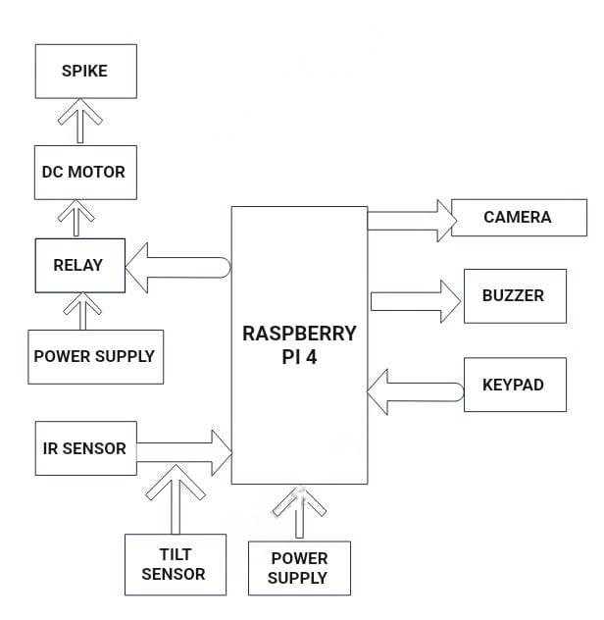
BLOCK DIAGRAM

Slide 8
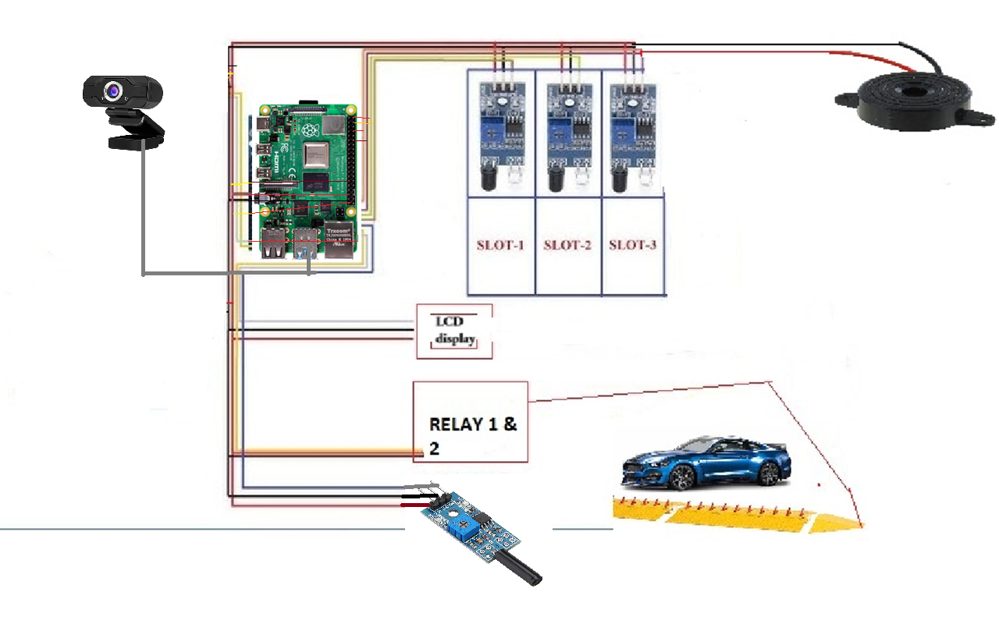
CIRCUIT DIAGRAM

Slide 9
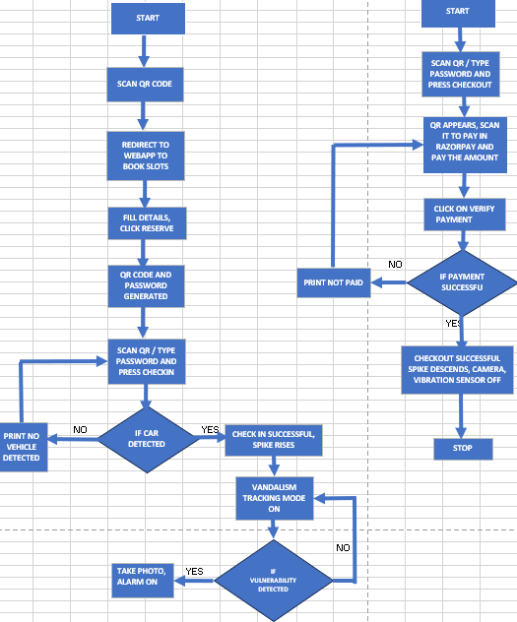
FLOW CHART
CHECK IN
CHECK OUT

Slide 10
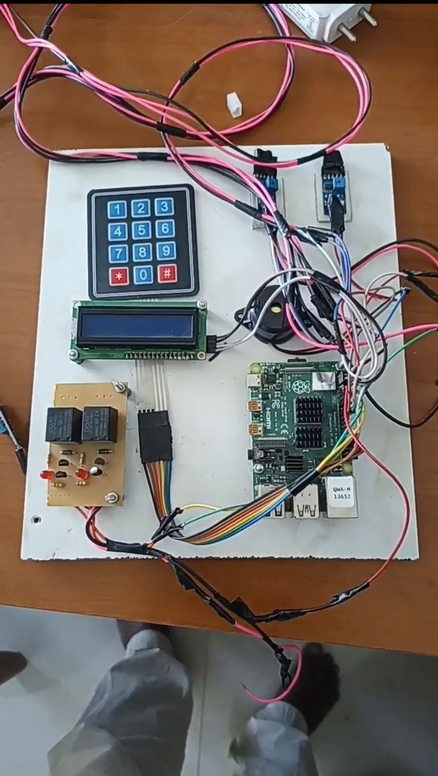
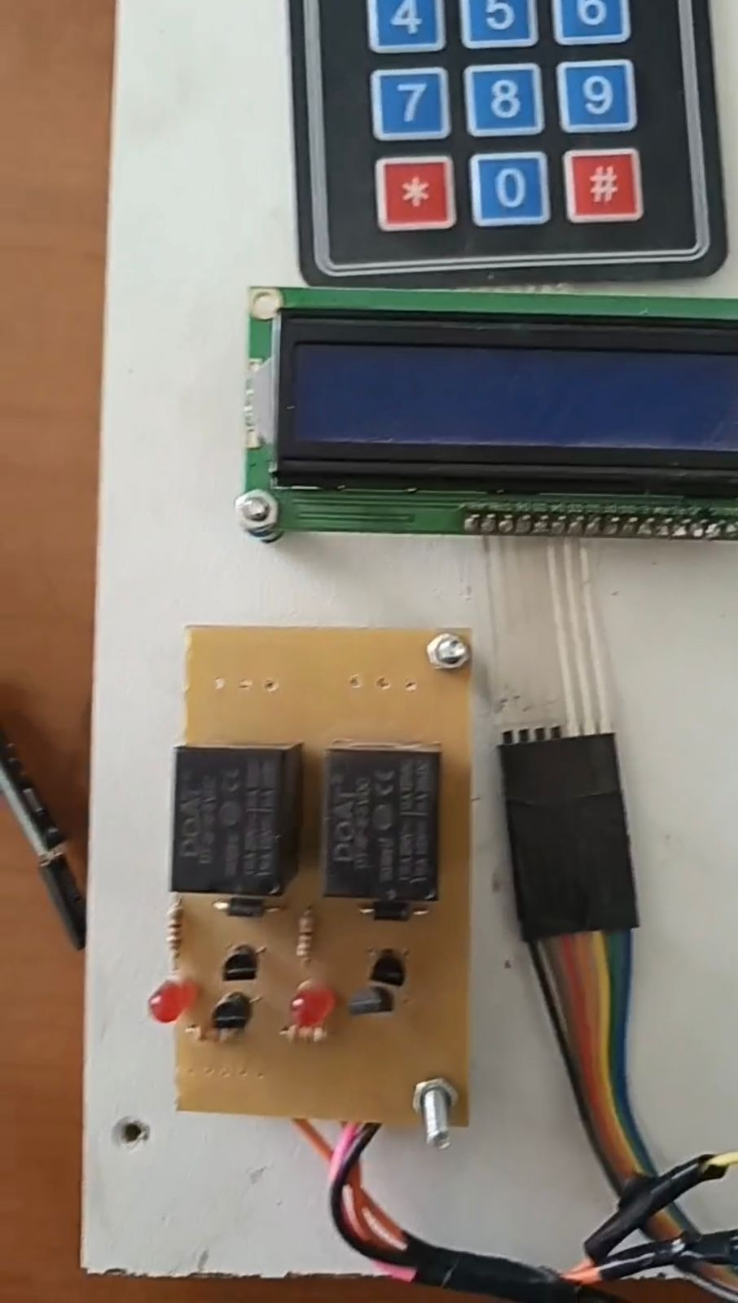
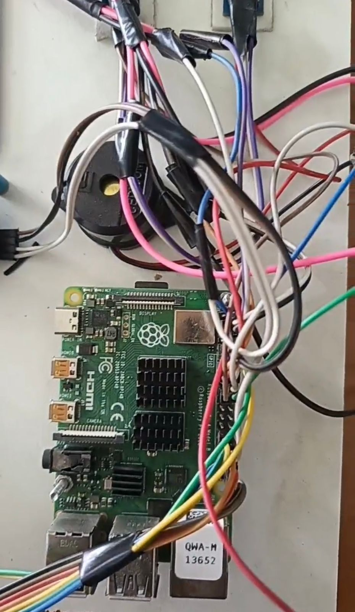
WORK DONE

Slide 11

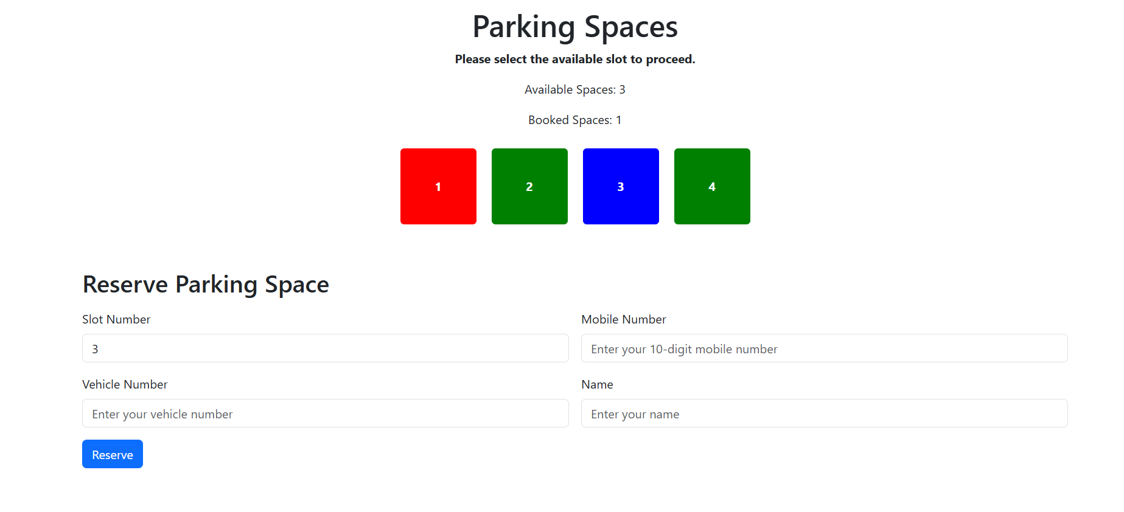
WORK DONE SO FAR

Slide 12
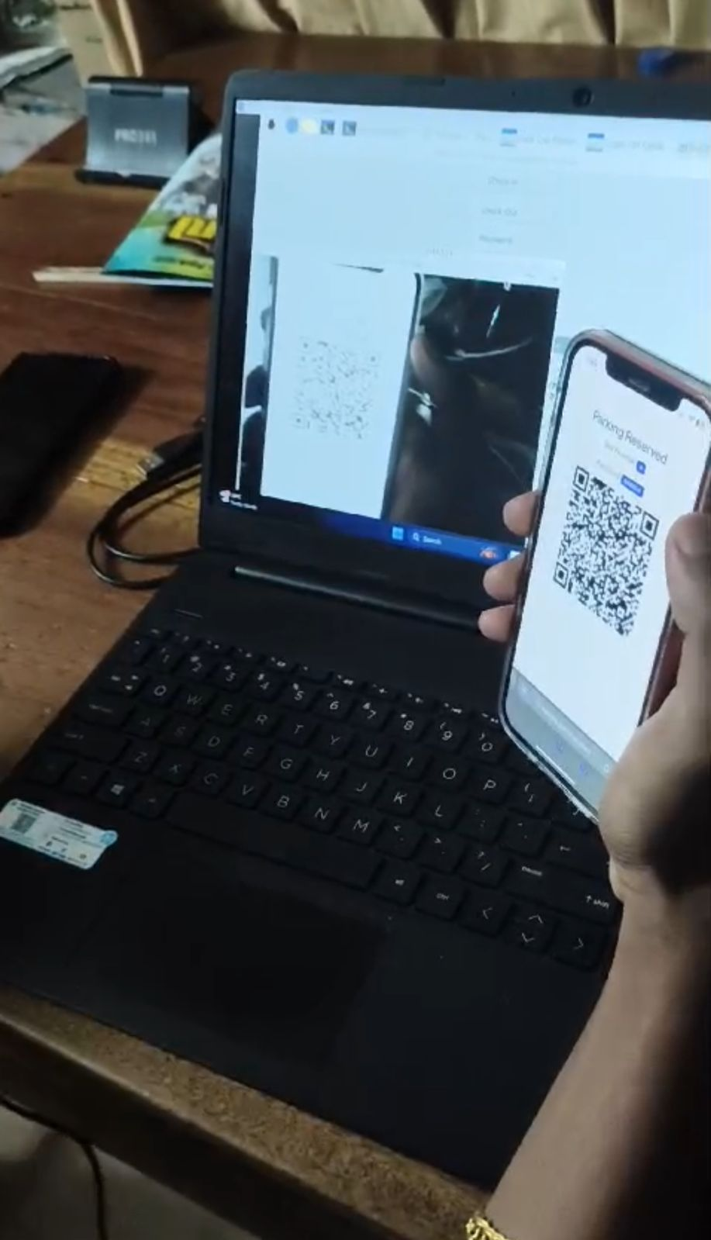
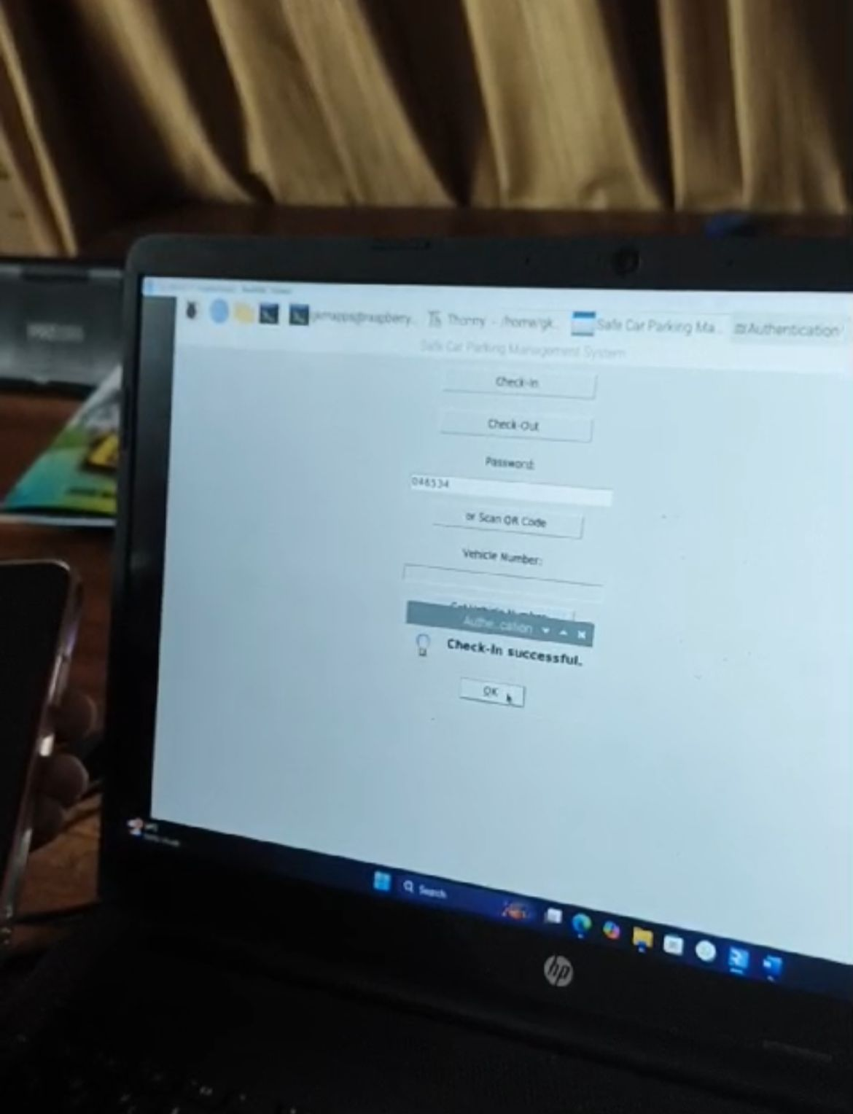
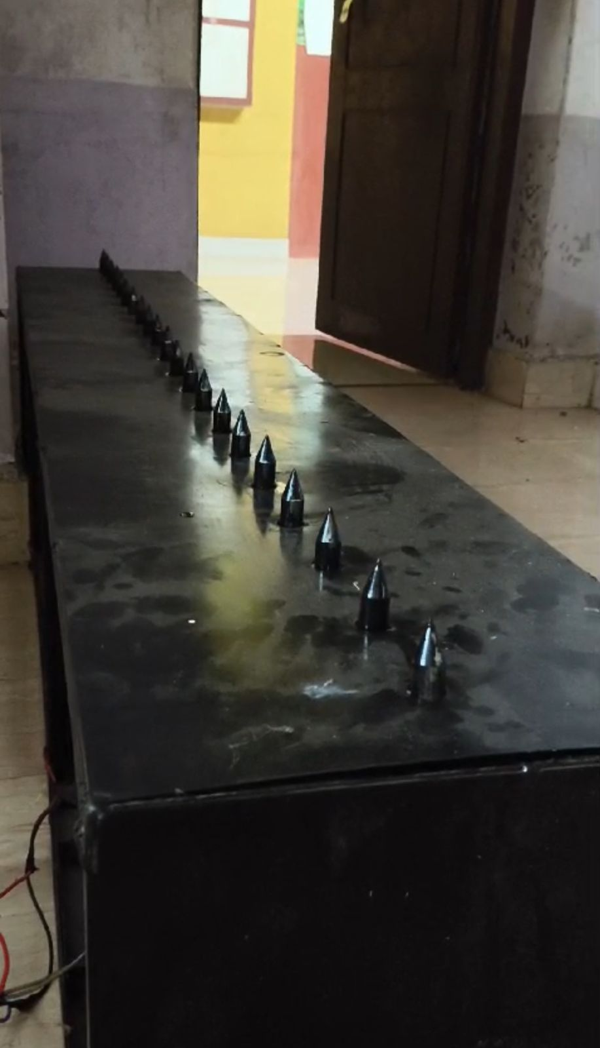
STEP 1:- SCAN QR / TYPE PIN
STEP 2:- CLICK CHECKIN
STEP 3:- SPIKE RISES

Slide 13
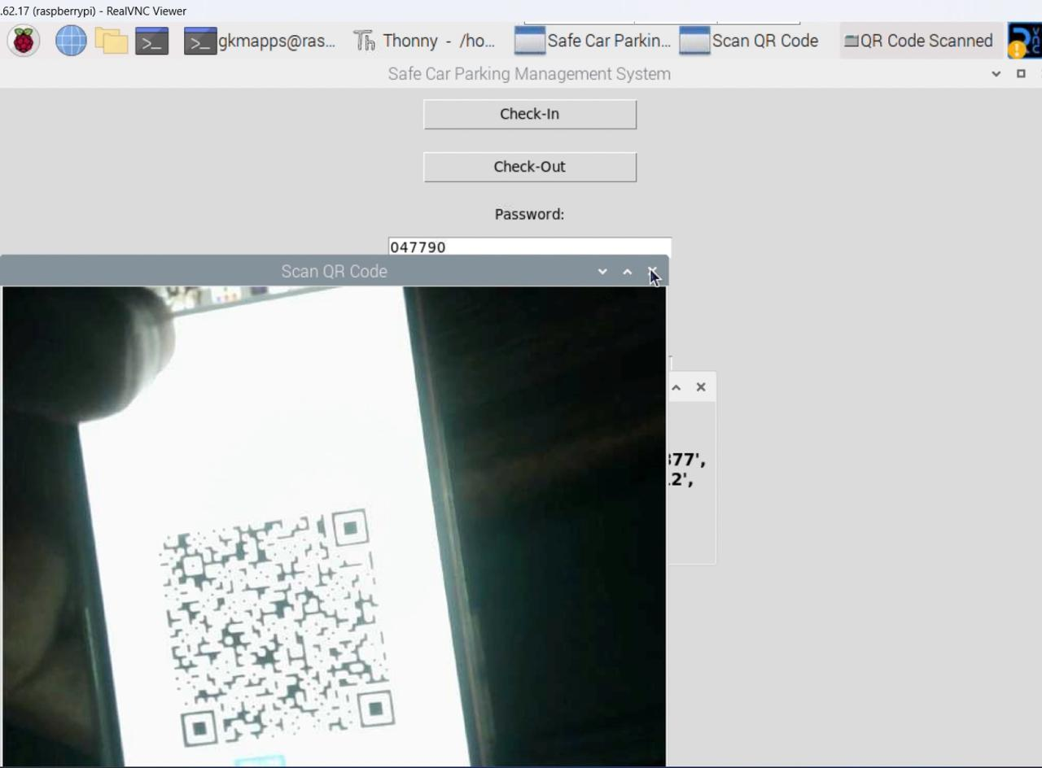
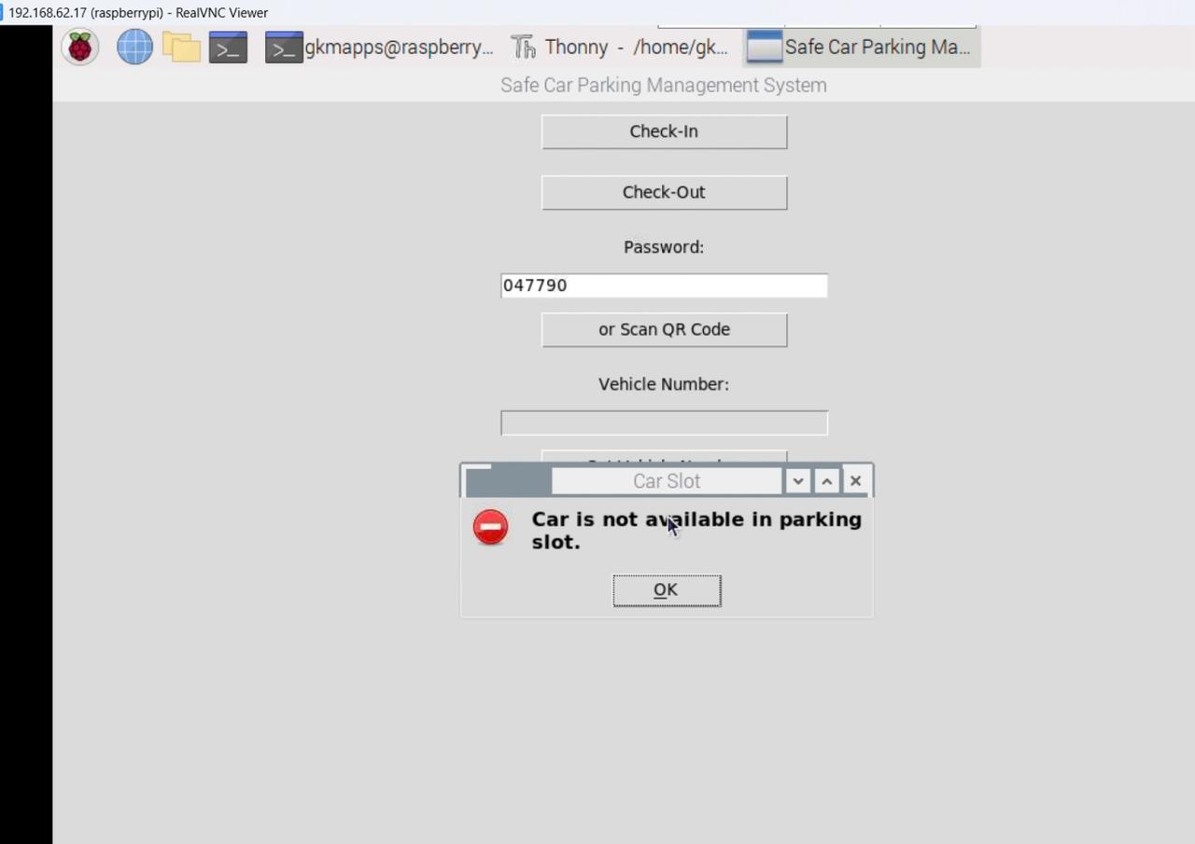
STEP 1:- SCAN QR CODE OR PASSWORD GENERATED WHILE RESERVATION
STEP 2:- IF CAR NOT AVAILABLE, POPUP APPEARS

Slide 14
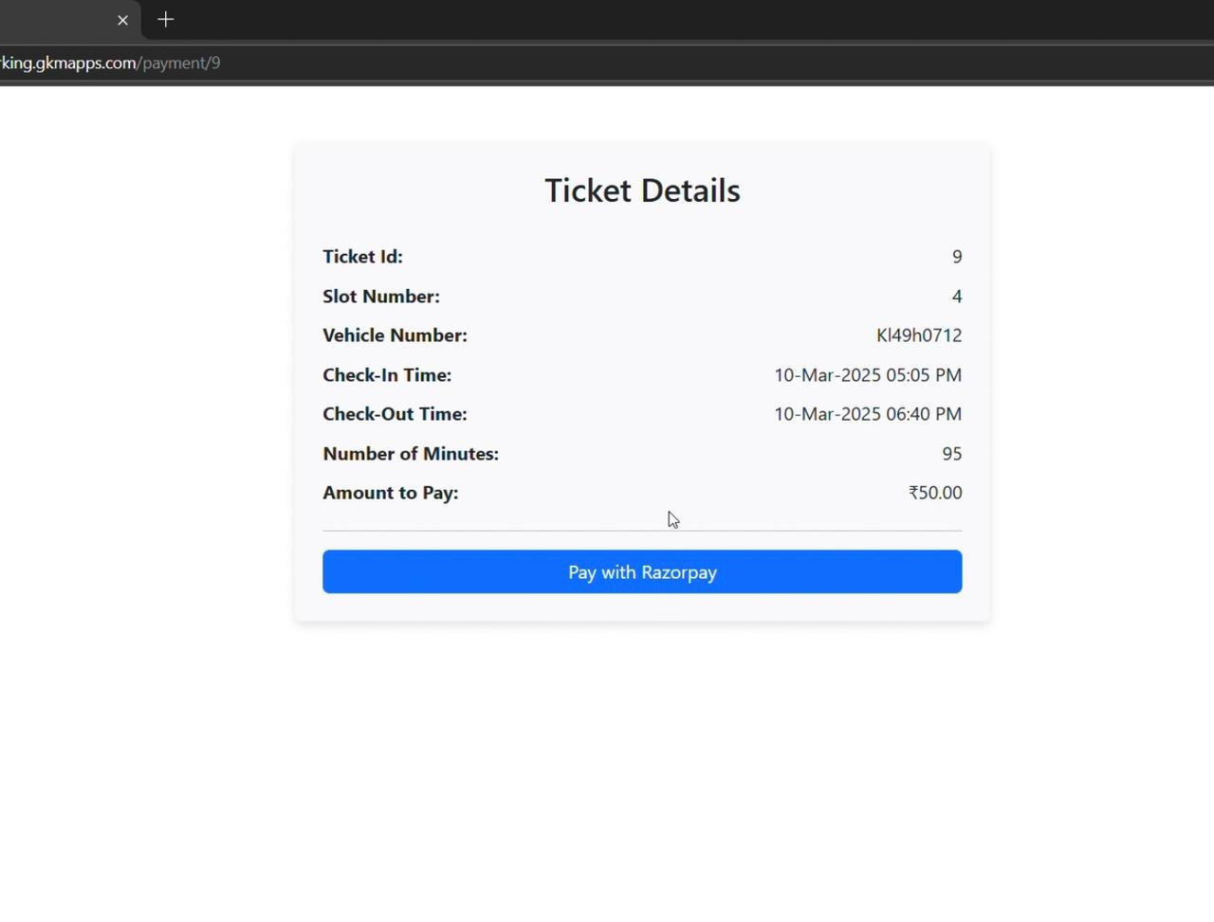
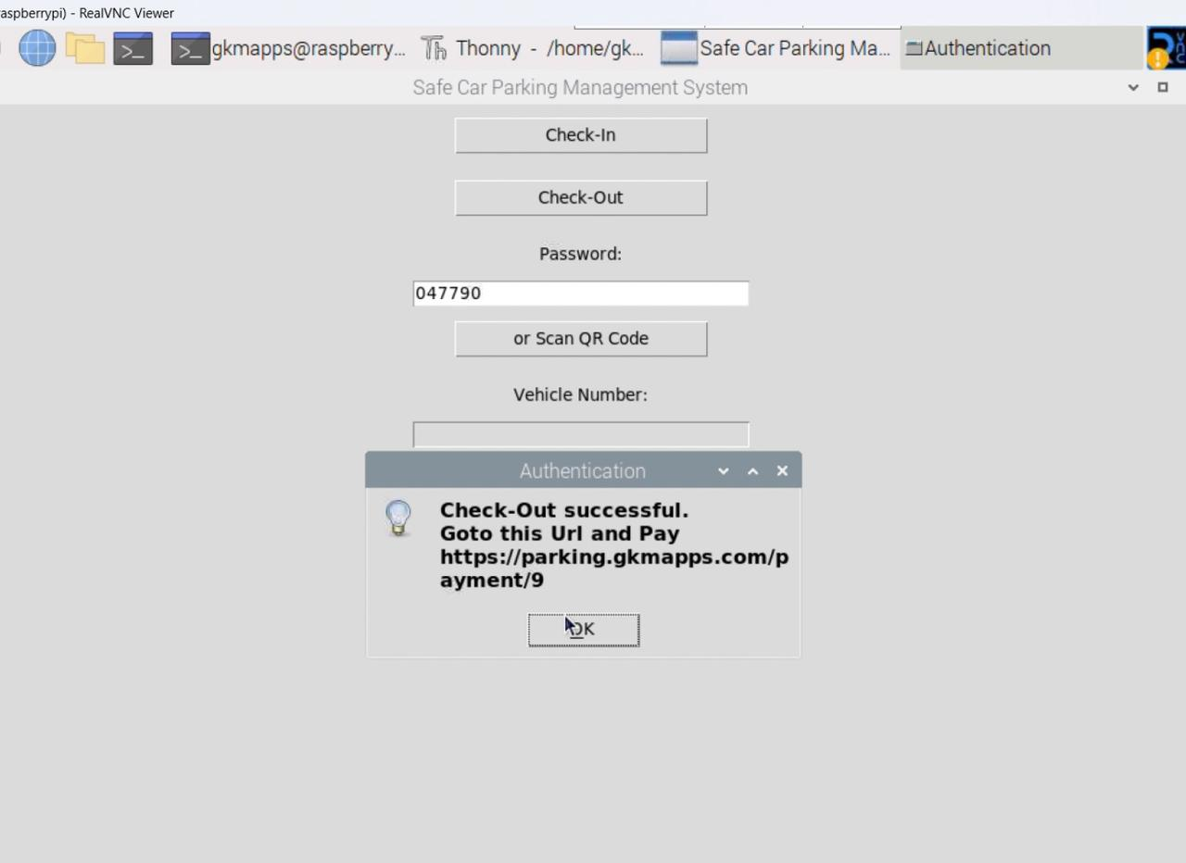
STEP 4:- AMOUNT TO BE PAID DIALOGUE BOX APPEARS
STEP 3:- IF CAR AVAILABLE , URL APPEARS TO PAY AMOUNT

Slide 15
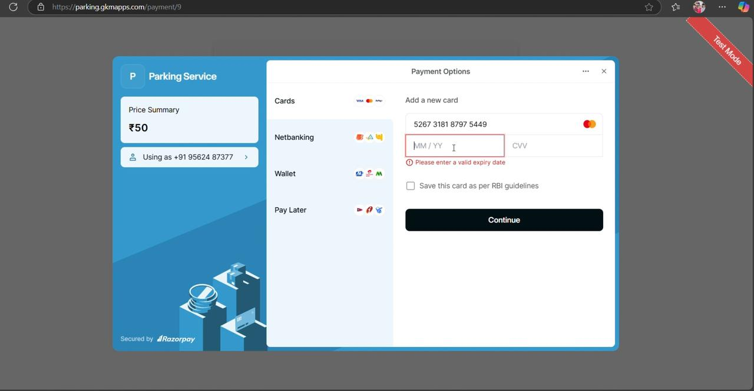
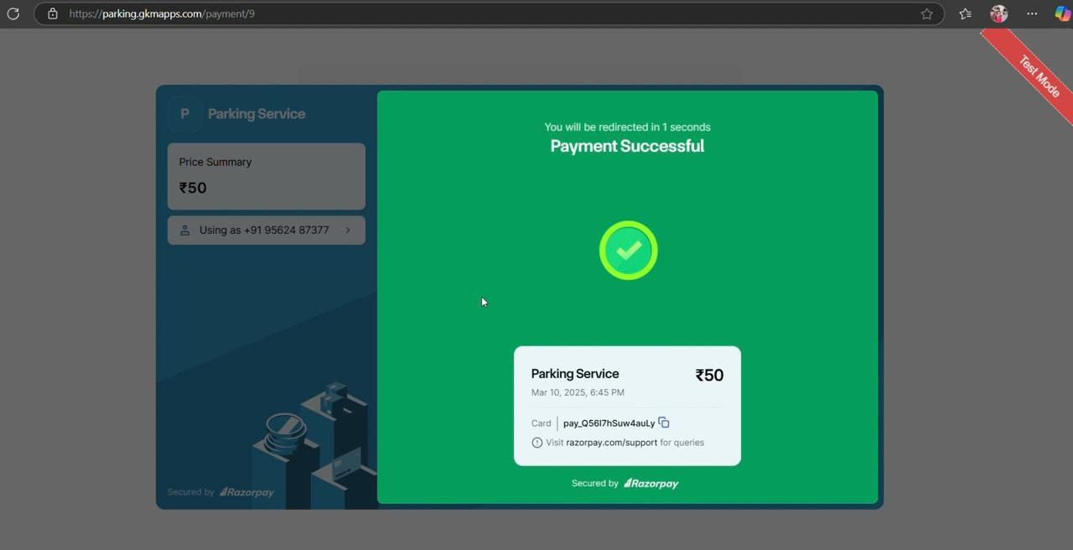
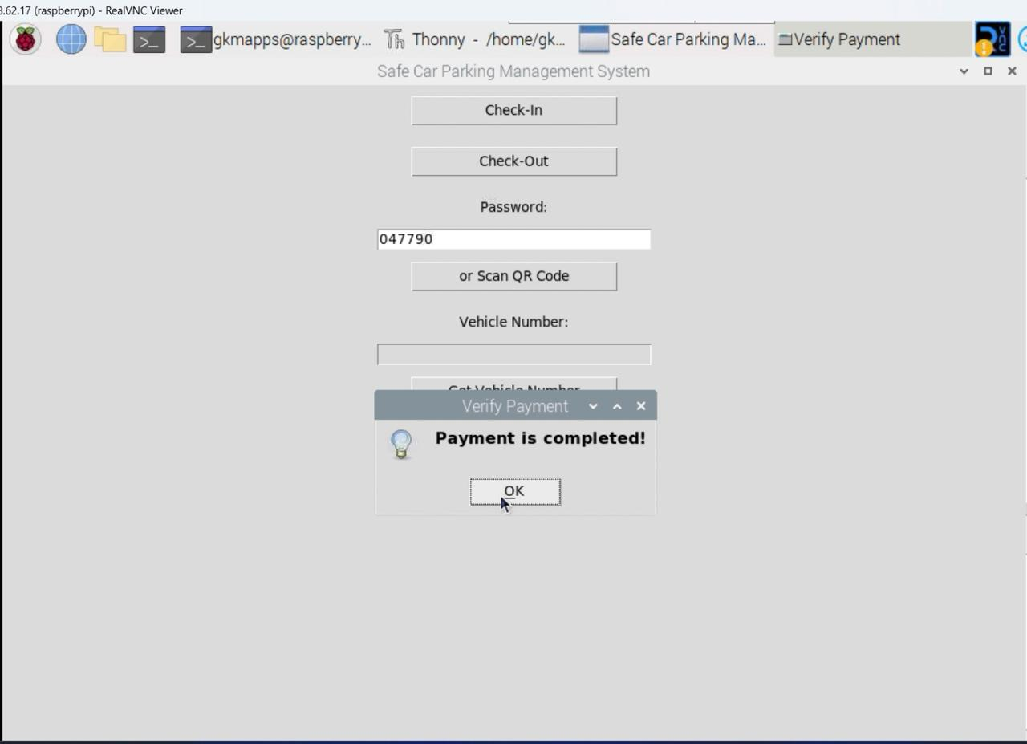
STEP 5:- REDIRECTED TO PAYMENT PAGE
STEP 6:- PAYMENT SUCCESS , SPIKE COME DOWNWARDS

Slide 16
THANK YOU

